Slide 1
CCPA: A Concurrent Content Processing Architecture for Hardware Firewalls
David Chen
ISPASS 2026
Notes:
Good morning and afternoon. My name is David Chen, third year Phd in UIUC ECE department, advised by Professor Rakesh Kumar. Today I'll be presenting CCPA, a Concurrent Content Processing Architecture for hardware firewalls. The core idea is simple: today's hardware firewalls serialize packet processing unnecessarily, and by decoupling just the part that truly needs to be serial, we can dramatically improve throughput on real-world traffic.

Slide 2
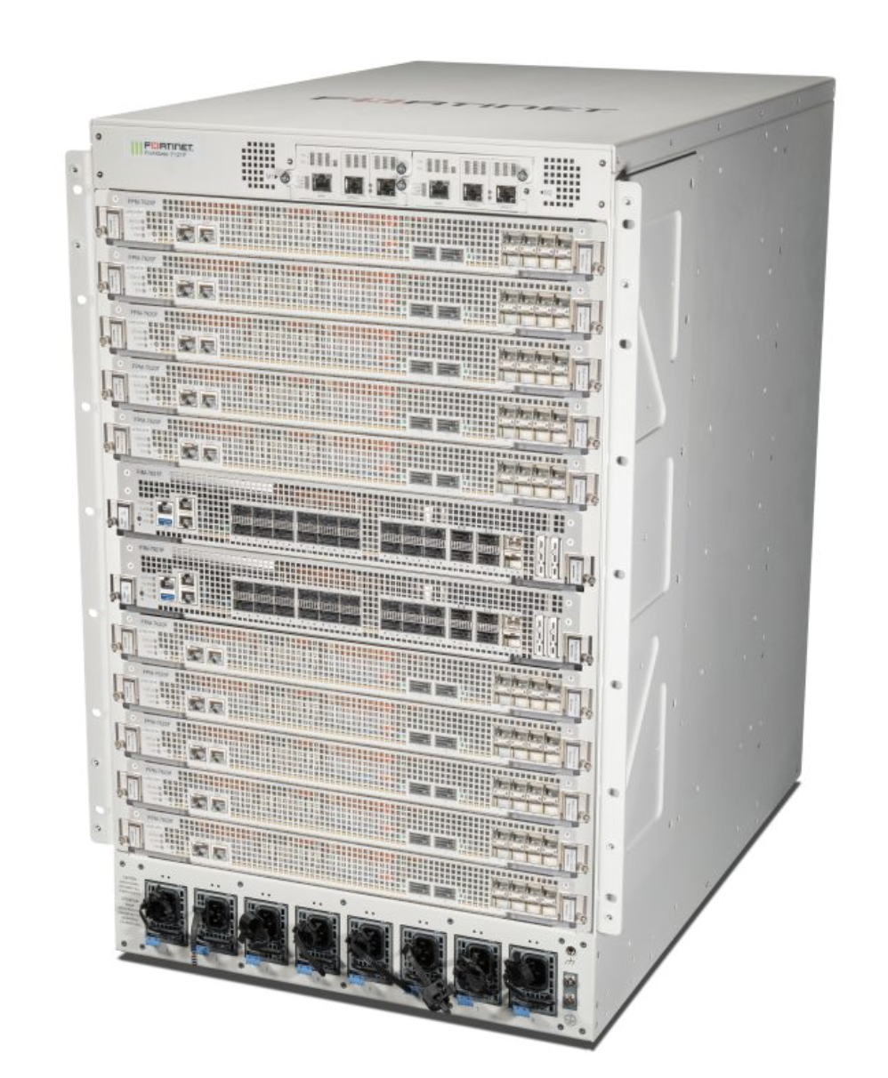
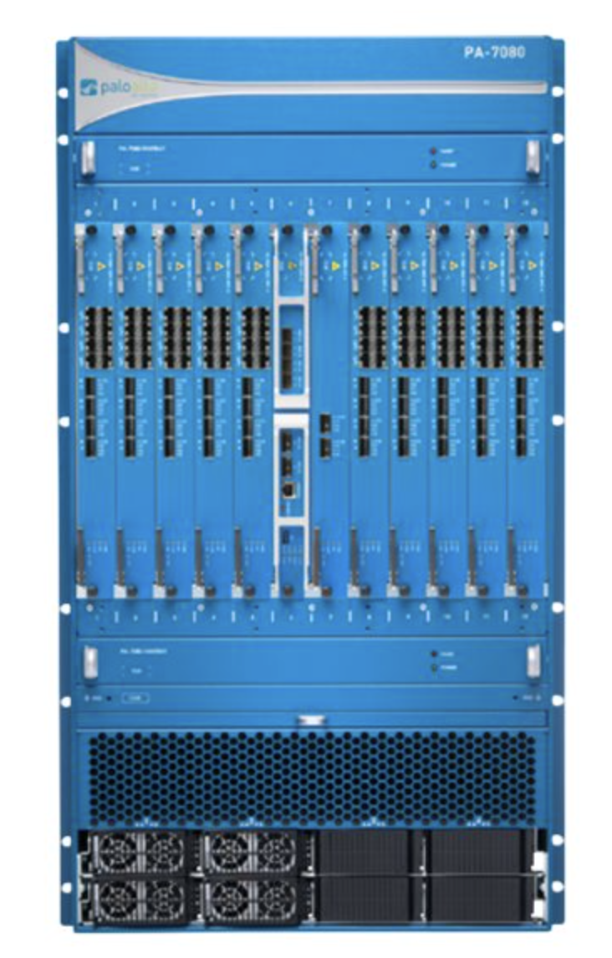
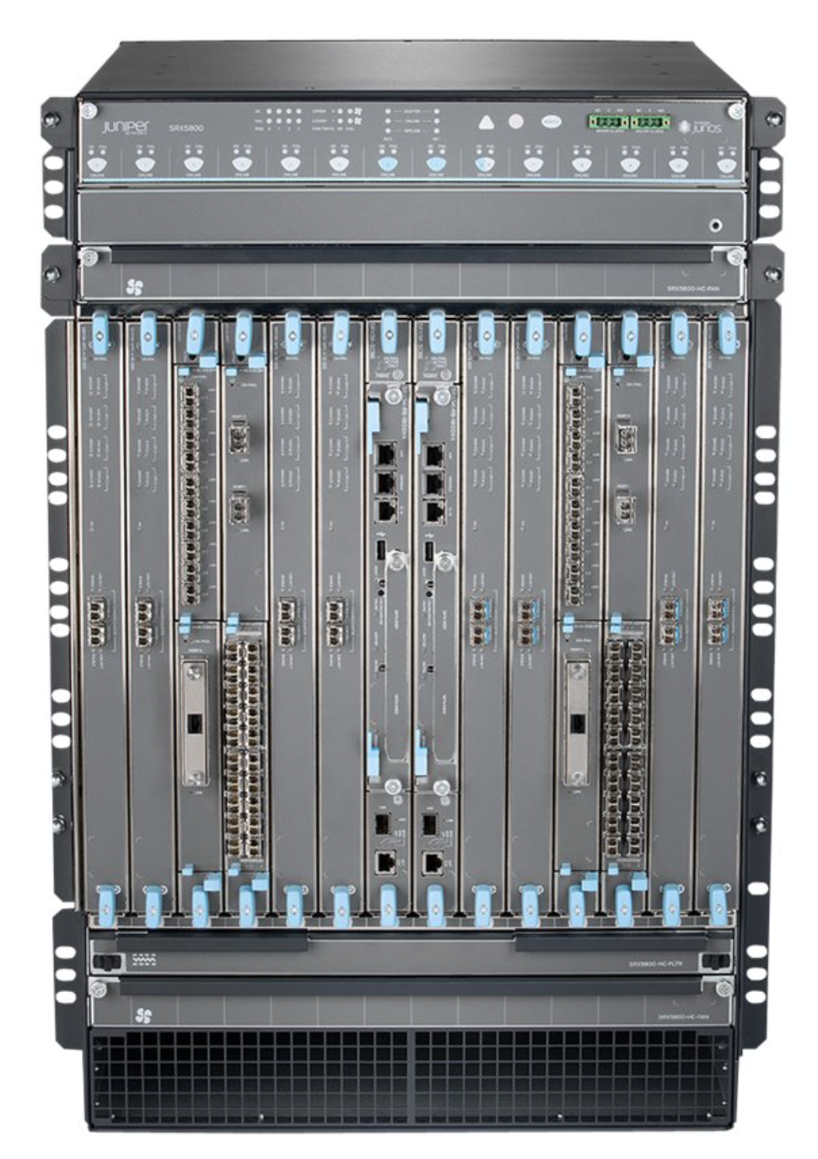
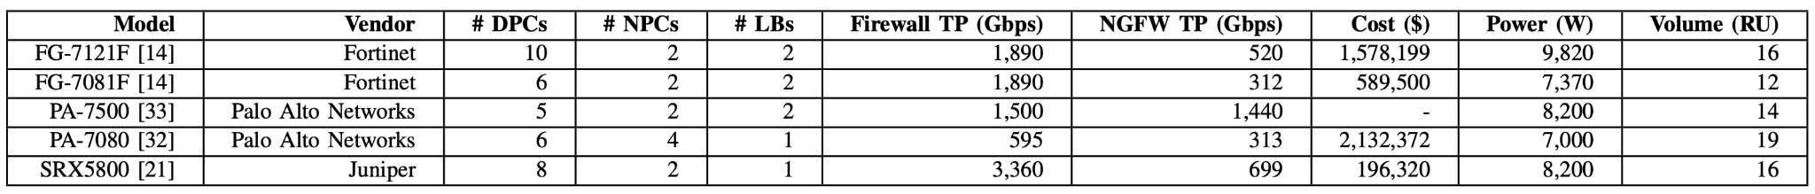
Why Hardware Firewalls Matter
FG-7121F
PA-7080
SRX5800
Notes:
Next-generation firewalls are the frontline defense for data centers and large enterprises. The high-end ones you see here cost up to two million dollars, draw close to 10 kilowatts, and occupy 16+ rack units. When you're paying that much per box, you need every DPC — every data processing card — to be doing useful work. Our work demonstrate that they are not well utilization in a lot of the settings today.

Slide 3
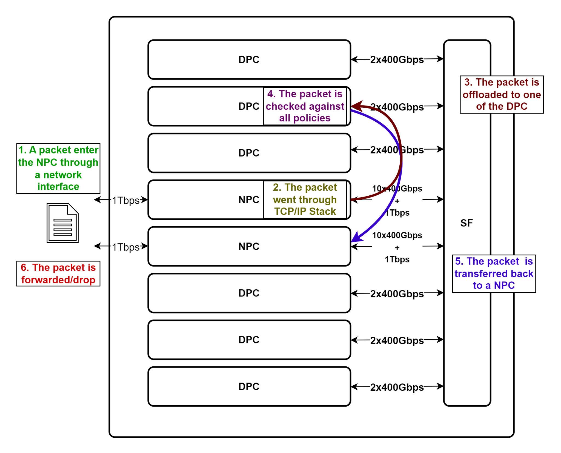
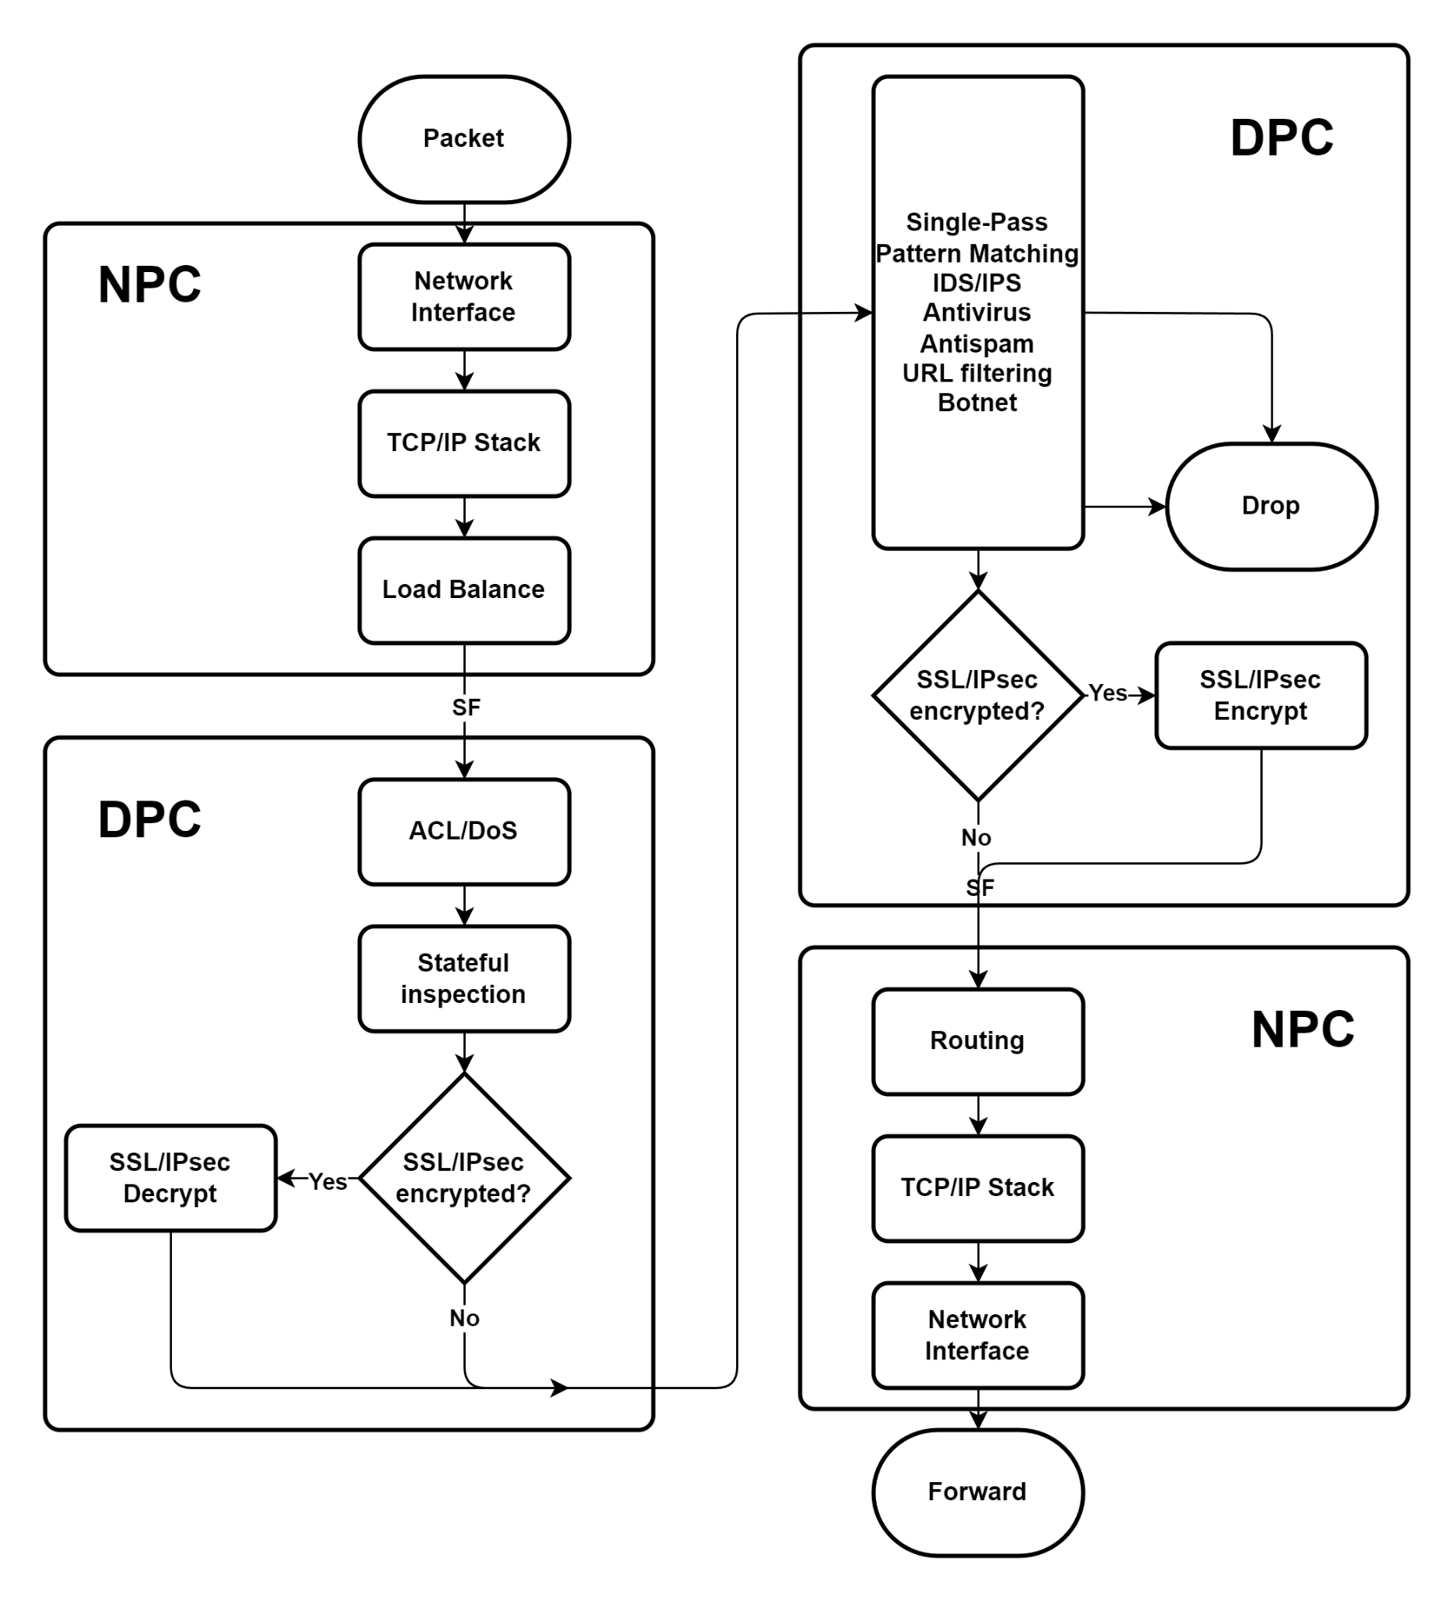
Firewall Architecture & The PCC Requirement
Notes:
Here's how a modern hardware firewall is organized. Packets come in, hit a network processing card for L2/L3 work, then a load balancer distributes them to a pool of DPCs where the expensive stuff happens — stateful inspection, signature matching, IDS, SSL decrypt.
The critical constraint is per-connection consistency, or PCC. Every DPC keeps its own local session table for modularity, and TCP treats out-of-order packets as congestion. So the load balancer is forced to pin every session to a single DPC for its entire lifetime. This is the architectural assumption we're going to challenge.

Slide 4
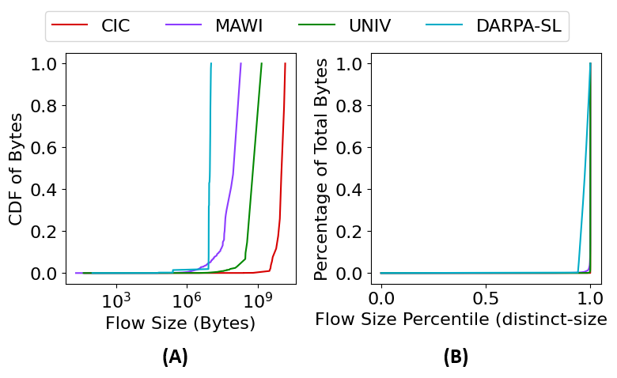
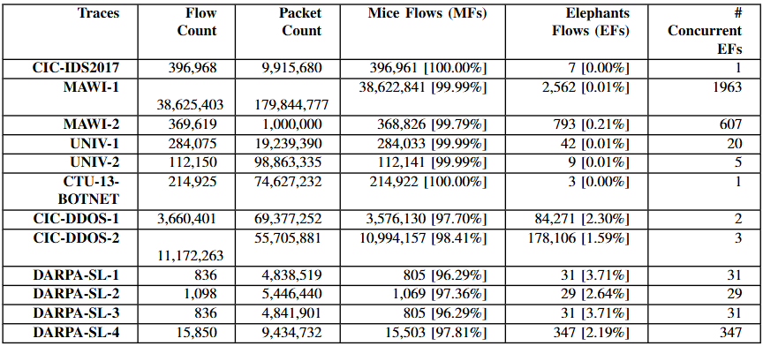
Real Traffic is Heavy-Tailed
Notes:
Real network traces are massively heavy-tailed. Across every trace we examined — backbone captures, university data centers, DDoS traces, enterprise — a tiny fraction of flows carries half the bytes. In some traces, 0.0017% of flows account for 50% of the throughput. These are what the networking community calls elephant flows, and they don't play well with PCC.

Slide 5
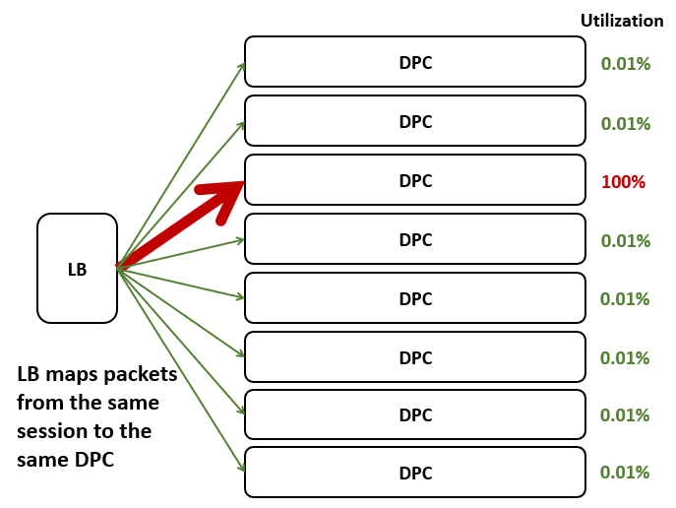
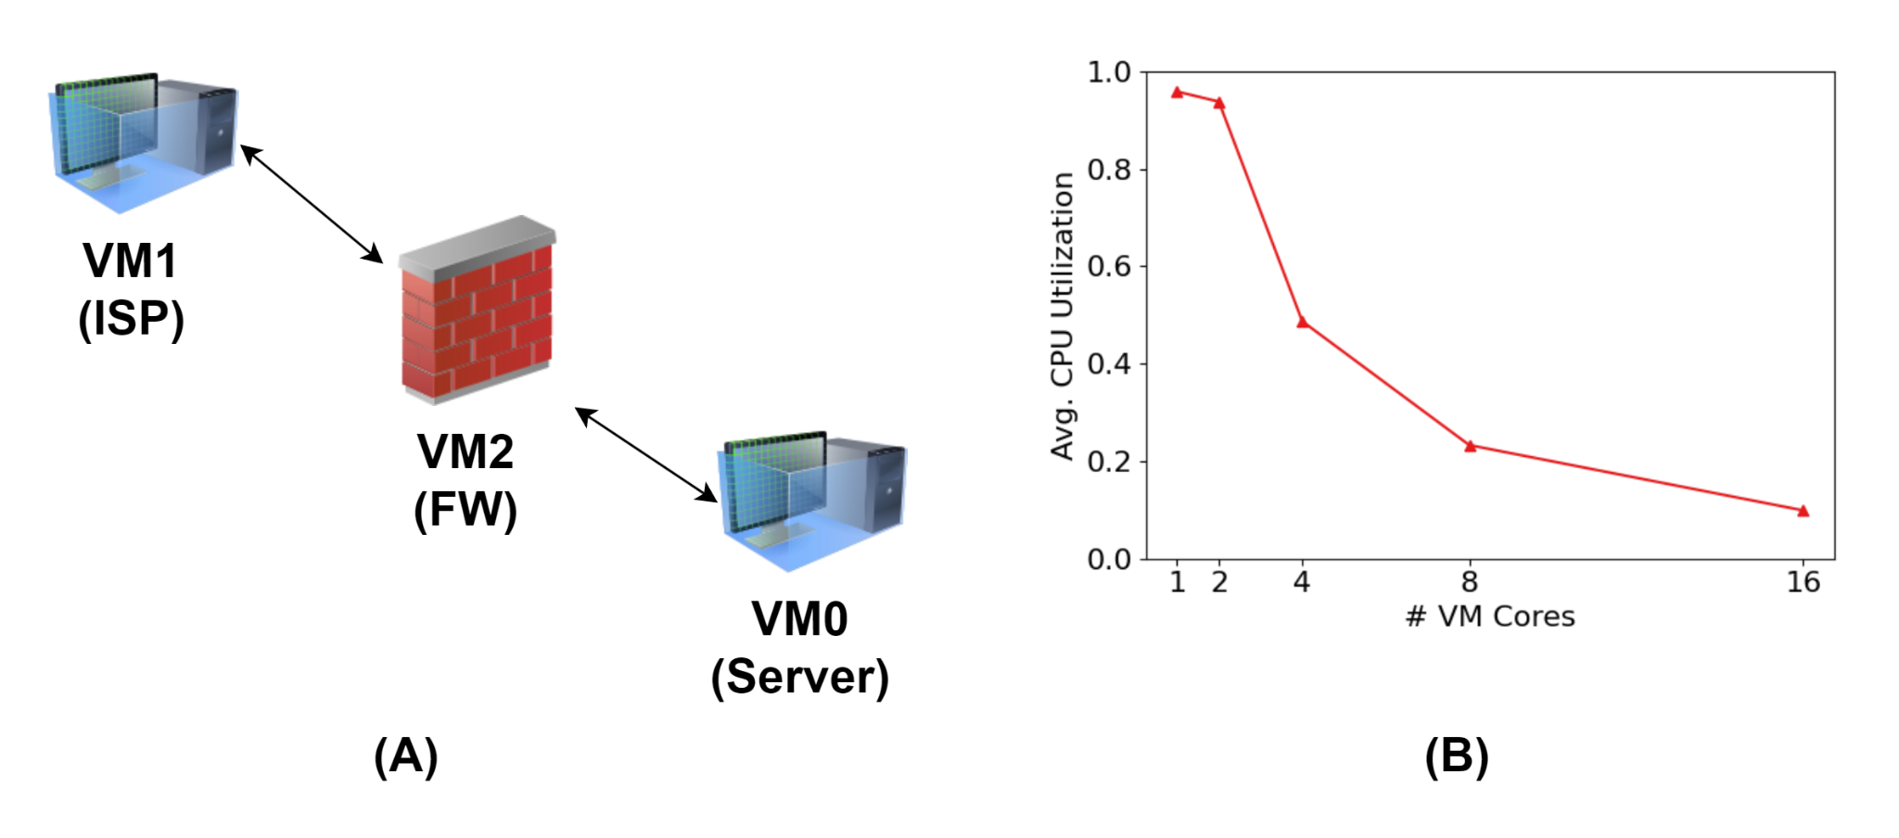
The Utilization Bottleneck
Notes:
Here's the problem in one picture. An elephant flow gets pinned to one DPC — that DPC saturates. The other DPCs are handling mice flows, which can't consume their capacity. We confirmed this on real hardware: running iPerf3 through an OPNsense firewall, adding cores actually reduces average utilization because a single session can't use them.

Slide 6
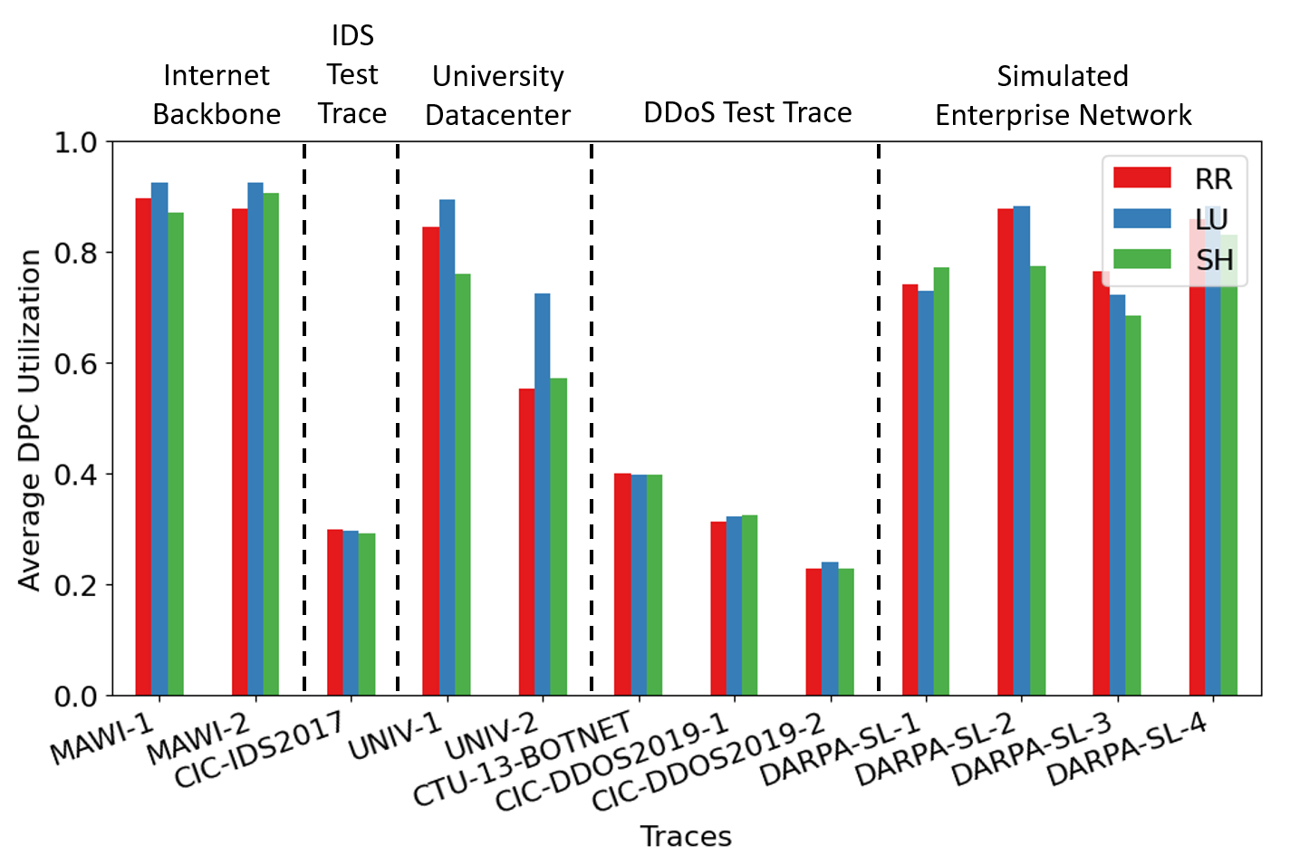
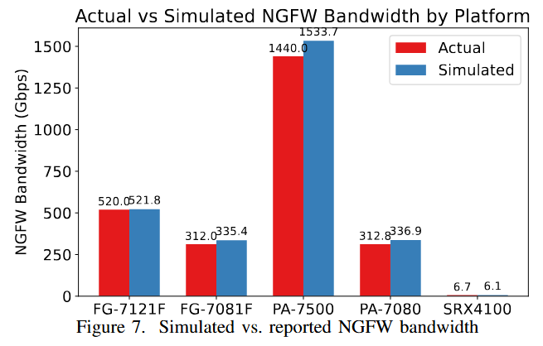
Simulator & Baseline Utilization
FW Simulator Developed:
Event driven
Validated against several commercial firewalls
Notes:
To quantify this systematically, we built a cycle-accurate event-driven simulator. The scheduler advances in 100-nanosecond quanta and walks the datapath graph in reverse topological order so back-pressure resolves in the same cycle. We validated it against five commercial firewalls — you can see here the simulated NGFW bandwidth matches reported numbers within a few percent.
Running real traces through this simulator on a 10-DPC firewall, we see DPC utilization collapse on traces with few elephants — 30% on CIC, 65% on UNIV. The specific load-balancing algorithm barely matters — whether you use round-robin, least-utilized, or symmetric hashing — because PCC is what's forcing the imbalance, not the algorithm.

Slide 7
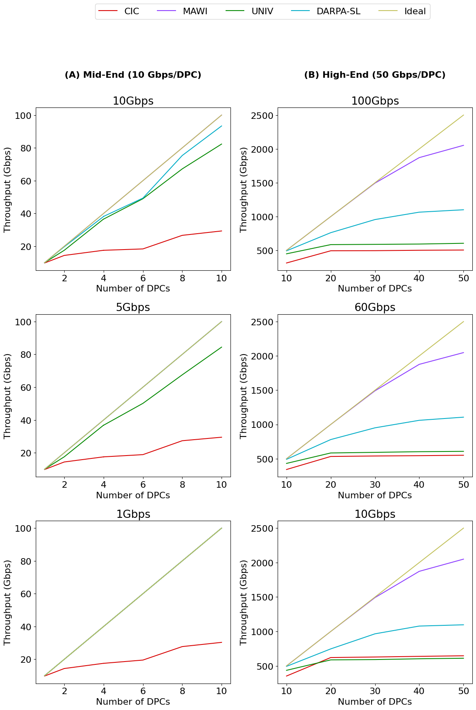
Utilization Collapses as DPCs Scale
Notes:
And it gets worse as you scale. Adding DPCs doesn't help elephant flows — they're still pinned to one card. The gap between ideal throughput and achieved throughput grows with every DPC you add.
Importantly, look at these curves for different backplane bandwidths — they're almost on top of each other. The bottleneck isn't backplane capacity. It's the PCC constraint itself.

Slide 8
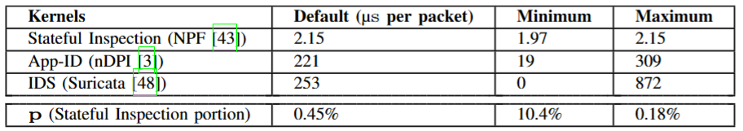
The Key Insight
*Split packet pipeline: stateful inspection (must be serial) vs. content inspection (can be parallel)
Notes:
Here's the observation that drives the whole paper. Packet processing has two main phases: stateful inspection, which touches shared session state and must be serial, and content inspection — signature matching, IDS, ML-based threat detection — which takes the packet, the policy, and the session state and does pattern matching. Content inspection is stateless per-packet.
We measured this with open-source kernels. Stateful inspection with NPF takes about 2 microseconds per packet. Content inspection with Suricata and nDPI takes hundreds of microseconds. Stateful is less than half a percent of the total work. We've been serializing 100% of processing to protect 0.45% of it.

Slide 9
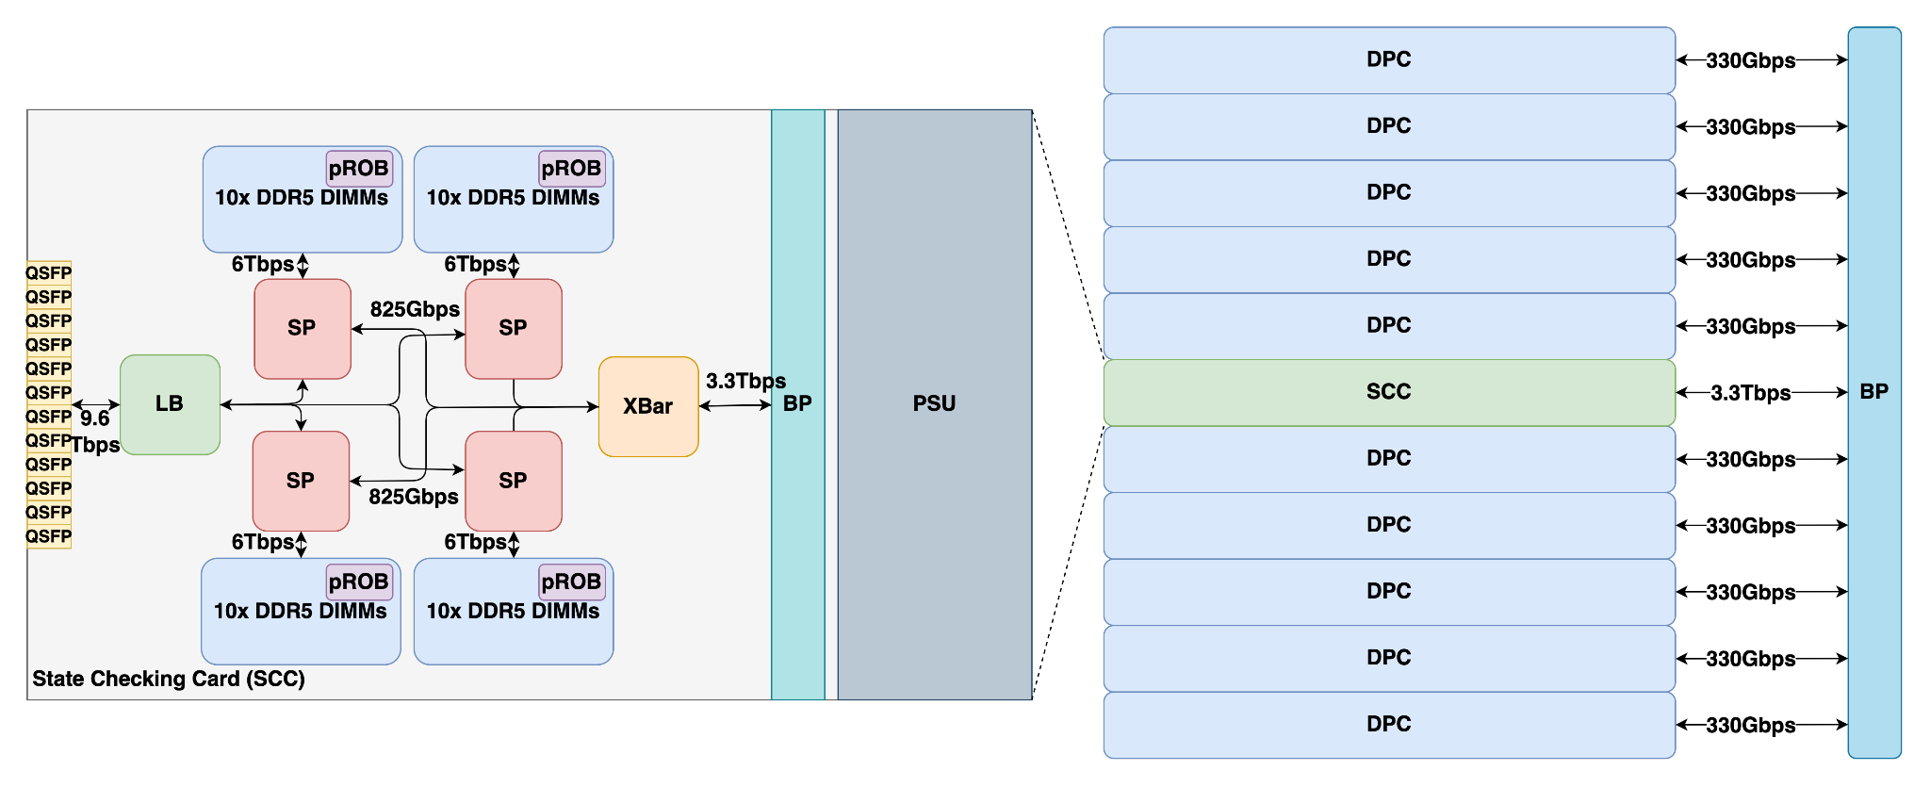
CCPA Architecture
Notes:
To leverage this insight, we introduce CCPA. We introduce a new module called the State Checking Card, or SCC, that sits before the DPC pool and handles only stateful inspection. The SCC has four state processors, each with its own session table in local DDR5 — we spec 2.56 terabytes per SP to match high-end NGFWs. A stateful load balancer pins sessions to SPs, so each SP's state is private and no cross-chip locking is needed.
Once stateful inspection completes, the SCC forwards the packet plus the updated session state to a DPC — round-robin, so elephant flow packets now spread across all DPCs. Content inspection is stateless given the forwarded state, so DPCs don't need to talk to each other.
We briefly considered letting DPCs do stateful inspection and then forwarding to peer DPCs for content work. That needs an all-to-all crossbar and adds about 640 nanoseconds per hop on a 7.5-microsecond port-to-port budget. The dedicated SCC avoids this entirely.

Slide 10
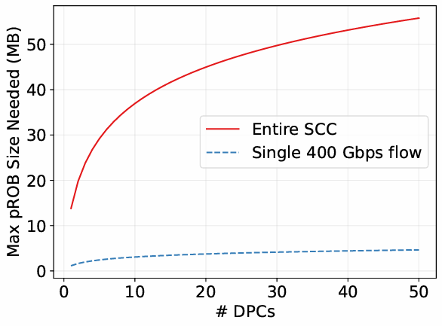
In-Order Egress
Problem: parallel content inspection → packets finish out of order; TCP reorder window is 3 packets.
Solution: packet ReOrder Buffer (pROB) at the SCC; forward packet N only after N-1 is done
Notes:
However, there is 1 issue: if DPCs finish in parallel, packets can leave out of order, and TCP will trigger retransmits after three out-of-order packets. We solve this with a packet reorder buffer, pROB, at the SCC — a packet only egresses after the previous one has been cleared. The worst-case pROB size stays under 60 megabytes even at 50 DPCs, which is very manageable.
Two other efficiency wins: the DPCs return only the decision, not the packet, cutting backplane bandwidth by half. And for the small number of rules — we audited Suricata and it's 5.4% — that genuinely need cross-packet sequential state, we fall back to PCC.

Slide 11
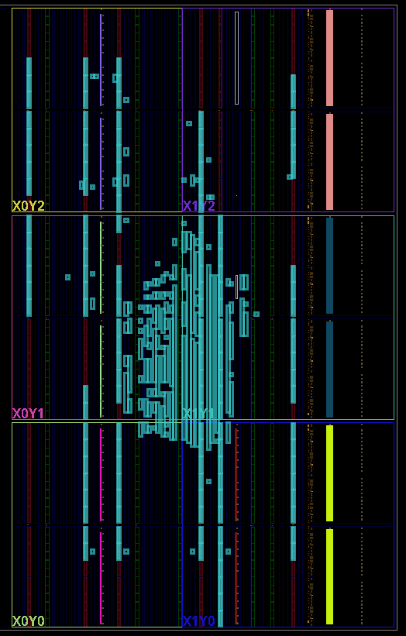
FPGA Prototype
Zynq-7000 implementation of state processor
5% LUT utilization, >400 MHz, 1 Gbps on minimum-size packets
Tested with random-packet simulation testbench
No drops, no reordering
Notes:
To show this is buildable, we prototyped the state processor in Vitis HLS and mapped it to a Zynq-7000 FPGA. It closes at over 400 megahertz, uses only 5% of LUTs, and sustains a gigabit on minimum-size packets. We exercised it with a random-packet testbench and saw no drops and no reordering.

Slide 12
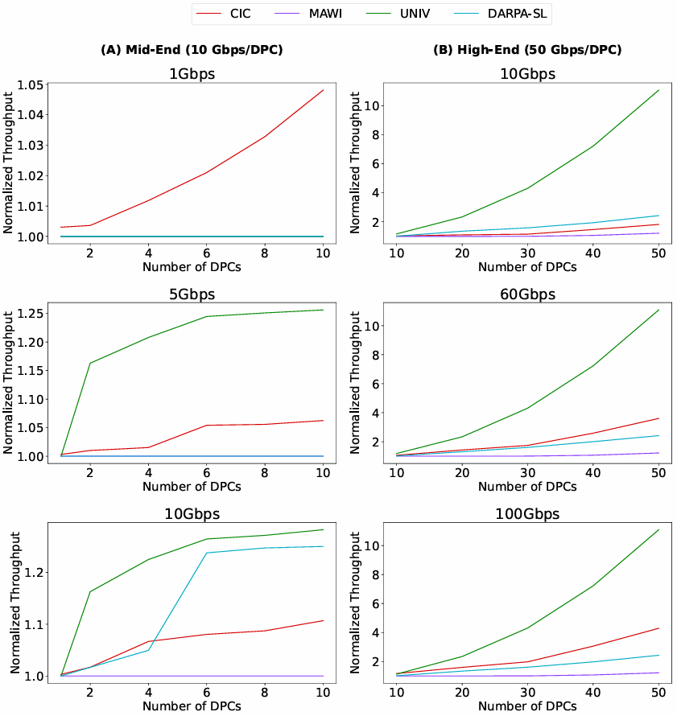
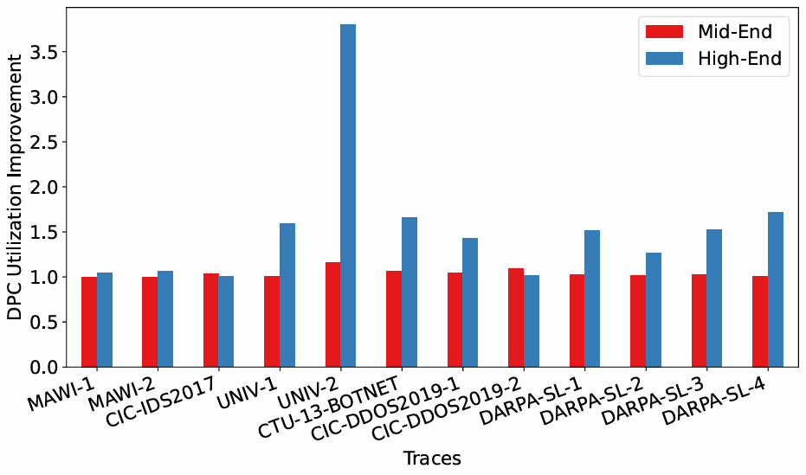
Results
Notes:
Here are the main results. On high-end firewalls — 10 to 50 DPCs at 50 gigabits per DPC — CCPA delivers an average 4.29× throughput improvement across all traces, with peak gains of 11× on the university data center trace. UNIV benefits most because it has few concurrent elephants, which is exactly the case where the baseline suffers most. With a future optical backplane, the average goes up to 14.4×.
On mid-end firewalls the gains are more modest — around 1.08× on average — because with only a few DPCs the baseline architecture is already reasonably utilized. The gains grow with scale, which is where the industry is heading. Looking at raw DPC utilization, we see up to 3.5× improvement on high-end configurations.
And this comes cheaply: the SCC plus its DRAM adds 3.35% cost and 16% power on a high-end firewall, for a 4.29× throughput gain.

Slide 13
Conclusion
Recap: PCC over-serializes → utilization collapses on heavy-tailed traffic
Insight: stateful is <1% of work; only it needs serialization
CCPA: dedicated SCC does stateful, DPCs do parallel content inspection
Results: 4.29× / 14.4× (w/ optical backplane)
First work identifying and addressing this bottleneck in hardware firewall architecture.
Feel free to email me at sc60@illinois.edu for any questions!
Notes:
To summarize: today's hardware firewalls over-serialize because they conflate stateful and content inspection. By separating the two and dedicating a state checking card to the sequential part, CCPA gets 4.29× on average, up to 14.4× with an optical backplane, for only 3% extra cost. To our knowledge this is the first work to identify and address this particular bottleneck in hardware firewall architecture.

