Slide 1
Waferscale Network Switches
Shuangliang (David) Chen
Saptadeep Pal
Rakesh Kumar
Notes:
*Good Afternoon, everyone!*
Hi, my name is David Chen, a first year Phd student at UIUC, advised by Professor Rakesh Kumar. I will be introducing our work on wafer scale network switches, where I show that waferscale integration can increase the radix of today’s switches by 32x.

Slide 2
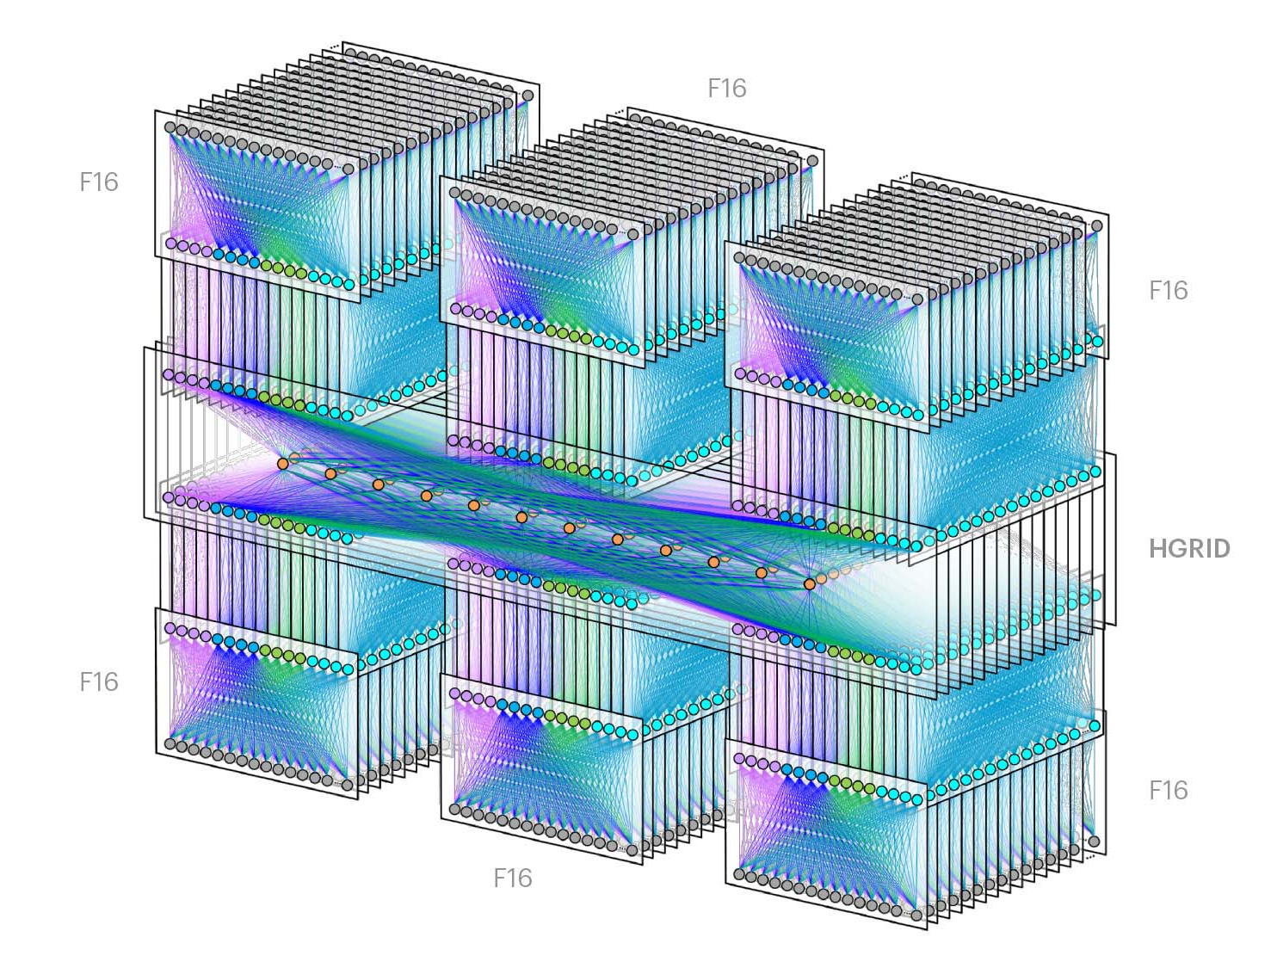
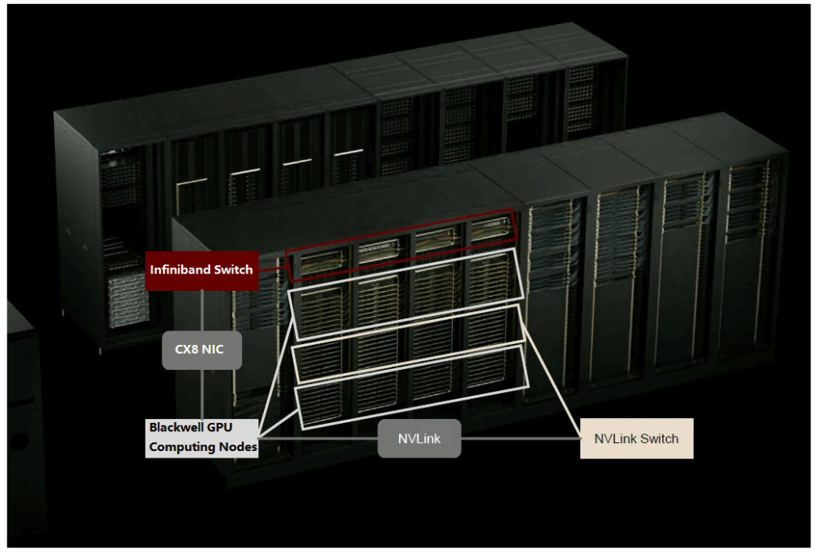
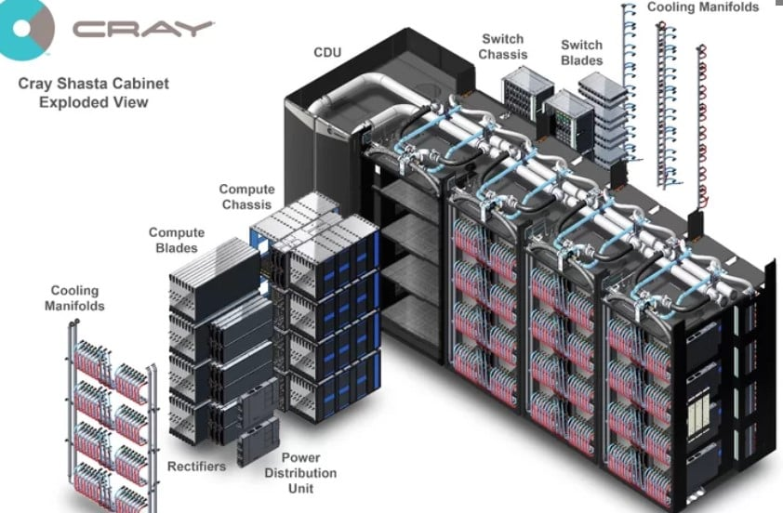
Network Switches
Data Centers
HPC
GPU Clusters
A critical component of modern computing infrastructure
Notes:
Network switches are ubiquitous in today’s computing infrastructure. They be found in Data centers such as this one from Meta which uses thousands of switches to interconnect all servers across six buildings. They can be found in HPC systems such as this Cray Shasta supercomputer where they are used to interconnect all compute nodes. They can also be found in GPU clusters such as this NVIDIA DGX SuperPOD where Infiniband switches are used for CPU communication and NVLink Switches are used for GPU communication. As such, Network switches are a critical component of modern computing infrastructure.

Slide 3
Switch Radix
Radix: the number of bidirectional ports on a switch
High radix is critical to reducing latency, cost, power, and volume, and improving scale
Notes:
The architecture of a switch is often characterized by its radix. Radix of a switch is defined as the number of bidirectional ports on the switch. A high radix is critical to reducing latency, cost, power, and volume, and improving the scale of the network.
Consider the following example. Suppose I have a switch with radix-4. I can use this switch to connect 4 servers. Now let’s say I want to connect 8 servers. I now need 6 switches to connect them. *However*, If I have a switch with radix-8, I would only need a single switch to connect the 8 servers.
This reduces latency of communication between servers as the communication is 1 hop instead of 3 hops. This reduces cost because we reduced the number of cables and transceivers needed by half. Having fewer switches also reduces power and volume.

Slide 4
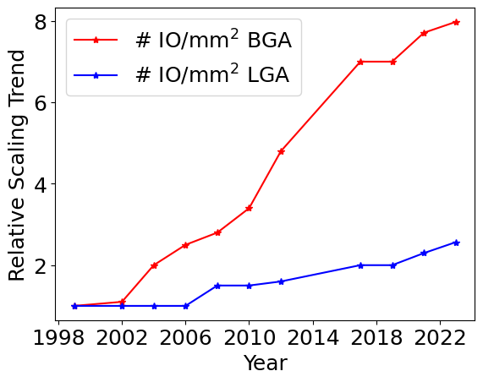
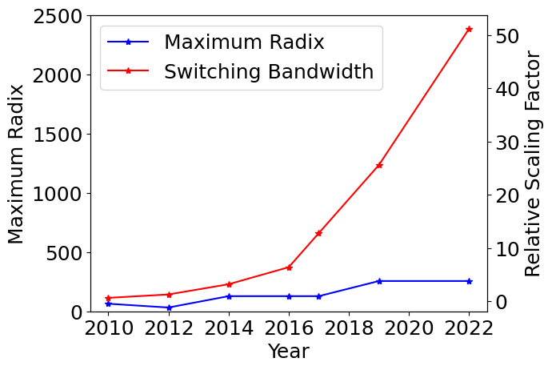
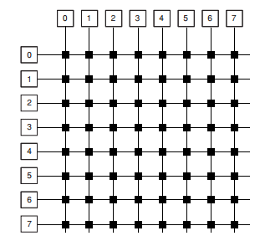
Building high radix switches is challenging
To increase the radix of a switch,
The number of I/O pins must increase
Unfortunately, I/O pitches scale poorly.
The size of the chip must scale,
Die sizes of crossbar-switches scale quadratically with radix
Unfortunately, chip sizes scale poorly due to yield concerns and reticle limit
Radix scaling extremely slow, radical solutions needed for significant increase in radix.
Notes:
So having higher radix switches is beneficial, but scaling up the radix of a switch is very challenging. To increase the radix, the number of I/O pins must increase to accommodate the IO pins of additional ports. Unfortunately, I/O pitches have scaled poorly over the years. Figure on the right shows the relative scaling of I/O pin densities over the last two decades. For BGA packaging, IO pin density has scaled only by 8x in the last twenty years. For LGA, it is even worse. IO pin density has scaled only by 2.3x in the last twenty. (pause) So, if IO density is not scaling well, we will need to increase the size of the chip to accommodate more ports to increase the radix. Another reason why increasing the size of the chip is necessary is that die sizes of crossbar-based switches scale *quadratically* with their radix, [pause] as shown in the figure. Unfortunately, chip sizes scale poorly due to yield concerns and reticle limits. As a result, the maximum radix achieved scales much slower compared to the aggregate switching bandwidth of the switch. While the switching bandwidth has grown by 50x in the last 10 years, the maximum radix of a switch has only grown by 5x. Therefore, a *radical* solution is needed to significantly increase the radix.
Too many colors
Graph too small

Slide 5
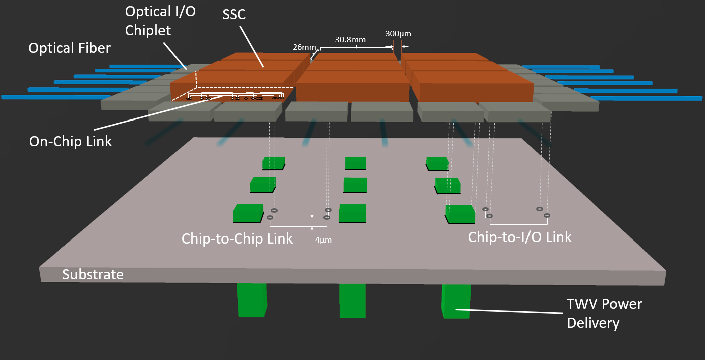
Our Proposal: A Waferscale Network Switch
Using chiplet-based wafer scale integration (WSI)
Periphery I/O Chiplet
Interconnect
Subswitch Chiplet
(SSC)
Area I/O
Notes:
*We propose* using a chiplet-based *wafer scale* integration technique to construct a very high radix switch that is as large as a wafer. We start with a single subswitch chiplet or SSC for short. It is an existing switch die with some radix. We take a large waferscale substrate, and bond many SSCs onto it. We connect them with the interconnect on the substrate. I/O signals can be supplied either via periphery I/O chiplets or Area I/O from the back or front of the die.
As a specific example, here we have a 3x3 wafer scale switch. The SSCs are connected via chip to chip link on the substrate. The SSCs are connected to IO chiplet via chip-to-io link also on the substrate. As the chip-to-chip link is passive, it is not long range, so SSC has passthrough On-Chip links on them as well. Optical fiber directly enters the I/O chiplets. Power is delivered through the back, and the cold plate sits on top of the SSCs.

Slide 6
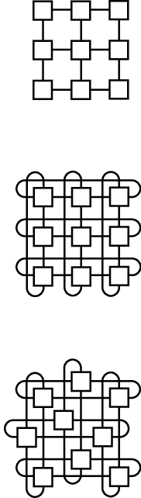
Topology Mapping For a Waferscale Network Switch
0
1
2
3
SSCs can be connected in different topologies to achieve the desired performance/cost trade-offs
Different logical network topologies can be mapped to a physical network of SSCs
Mapping Clos network to 2D mesh-connected switch
Clos is non-blocking, fault-tolerant, and offers high bisectional bandwidth
2D Mesh reduces complexity of manufacturing, placement and routing
4
5
6
7
8
9
10
11
0
1
2
4
5
6
8
9
10
Notes:
[Subswitch Chiplet] SSCs can be connected in different topologies such as Mesh, Torus, or Cube to achieve the desired performance/cost trade-offs. Different logical network topologies can be mapped to a physical network of SSCs. In this work, we chose to map the Clos network to the 2D mesh-connected SSCs. We chose Clos since it is non-blocking, fault-tolerant, and offers high bisectional bandwidth. We chose to use a 2D-Mesh physical topology as it reduces complexity of manufacturing, placement and routing.
I will show the mapping operation in an example. Here, 0 to 4 has a logical connection. That is mapped to physical network very easily. 0 to 5 can be mapped as 0 to 1, 1 to 5. Similarly, 0 to 6 can be mapped as 0 to 1, 1 to 2, and 2 to 6.

Slide 7
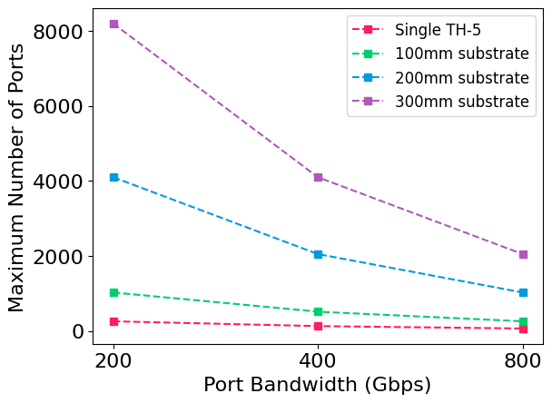
Waferscale Network Switches Promise Large Radix Benefits
32x higher radix than state-of-art!
Notes:
Our proposal promises large radix benefits if we just look at how many SSC dies could be fit on the substrate. Here X-axis shows the bandwidth per port in Gbps, and the Y-axis shows the maximum achievable radix.
At 200 Gbps, we could achieve radix of 8192, 4096, and 1024 for 300mm, 200mm, and 100mm substrate respectively. 8192 is 32x higher radix than state of the art, radix-256 tomahawk 5 or TH-5 for short.

Slide 8
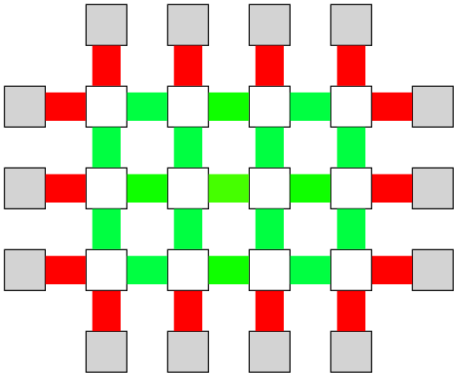
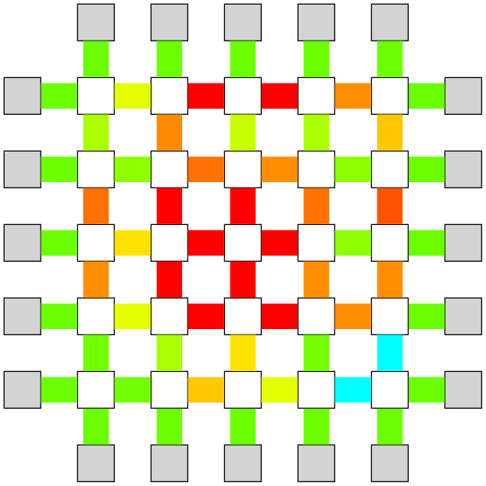
Bandwidth constraints limit the achievable radix
To support 8192 ports @ 200 Gbps with a 300mm substrate:
SERDES
Requirement
3000 Gbps/mm of external bandwidth density
6400 Gbps/mm of internal bandwidth density
Availability
SERDES: 512 Gbps/mm external
Optical I/O: 3200 Gbps/mm external
4 micron pitch x 4 layer x 3.2 GHz: 3200 Gbps/mm internal
100%
Bandwidth Utilization
75%
Radix 512
50%
25%
Optical I/O
0%
This discrepancy reduces the achievable radix
8x instead of 32x of radix benefits!
Radix 2048
Notes:
The reality is much more complicated. To achieve the promise of 32x higher radix, we need 3000 Gbps/mm of external bandwidth density, 6400Gbps/mm of internal bw density. If we assume SERDES-based external connectivity, we hit only 512Gbps/mm external bw density, so we are severely bottlenecked by io bandwidth, shown by these outer links in red. With optical I/O, we can achieve 3200Gbps/mm external bandwidth density, but now we are bottlenecked by internal bandwidth, shown by these inner links in red. For 4 micron internal io pitch, 4 layers of interconnect, and internal links running at 3,2GHz, we have 3200Gbps/mm of internal bandwidth density on the substrate. This discrepancy between requirement and availability reduces the achievable radix. We see only 8x benefit from waferscale integration instead of 32x.

Slide 9
Power and Cooling Challenges May Also Limit Achievable Radix
Handle power and cooling at 63 kW?
Radix-8192
Liquid Cooling
Air Cooling
Radix-2048
Radix-512
Notes:
Even if we forget about the bandwidth limitations, a waferscale network [switch] draws *excessive* power. The figure plots the required power for various radix that we achieved using SERDES, Area I/O and Optical I/O at 300mm substrate.
We see that at 8192 radix, the system uses 63kW. This is too high even for liquid cooling. We can only liquid cool the 2048 radix system. The situation becomes worse if we consider air cooling only.

Slide 10
Alleviating Bandwidth Constraint Through Deradixing
Use SSCs with lower radix
Reduces internal bandwidth congestion
Radix-256
Radix-128
Deradixing
Radix-4096
48 SSCs
Link Utilization: 150%
Radix-4096
96 SSCs
Link Utilization: 90%
8x without deradixing → 16x with deradixing
Notes:
To address the internal bandwidth problem, we propose the use of deradixing. Using lower radix SSCs that have the same die [size], we could alleviate the internal bandwidth congestion.
As we reduce the SSC radix from 256 to 128, we used twice the number of SSCs to achieve the same system-wide radix of 4096. However, because each SSC has half the required internal bandwidth, the bandwidth utilization went from over 150% to 90%.
So we achieve 8x benefits over baseline without deradixing, but 16x with deradixing.

Slide 11
Alleviating Power/Cooling Constraint Through Heterogeneity
Use lower radix SSCs for the leaf, reduces energy consumption
Power scales $O\left(n^{2}\right)$ with radix
$$\frac{P}{4}$$
$$\frac{P}{4}$$
$$\frac{P}{4}$$
P
P
$$\frac{P}{4}$$
P
P
$$\frac{P}{4}$$
$$\frac{P}{4}$$
$$\frac{P}{4}$$
$$\frac{P}{4}$$
Liquid Cooling
P
P
P
P
P
P
P
P
Air Cooling
$$\frac{P}{4}$$
$$\frac{P}{4}$$
P
P
$$\frac{P}{4}$$
$$\frac{P}{4}$$
P
P
$$\frac{P}{4}$$
$$\frac{P}{4}$$
$$\frac{P}{4}$$
$$\frac{P}{4}$$
30.8% reduction in power → allows a radix-8192@200Gbps switch for the same power budget
Notes:
To address the power consumption problem, we propose to use heterogeneous SSCs with different radixes. We observe that we could use 2 SSCs with half radix as the leaf node without changing the overall radix. We also know that power varies [quadratically] with radix, so we are able to reduce the overall power when compared to the homogenous SSC system without affecting the system radix.
Here the X-axis is the radix of leaf SSCs, and Y-axis is the total power. While maintaining the same system-wide radix, the heterogeneity optimization allows us to cool the 300mm system using liquid cooling using leaf SSCs with ¼ the radix. *So*, this 30.8% reduction in power which allows a radix-8192@200 Gbps switch for the same power budget.

Slide 12
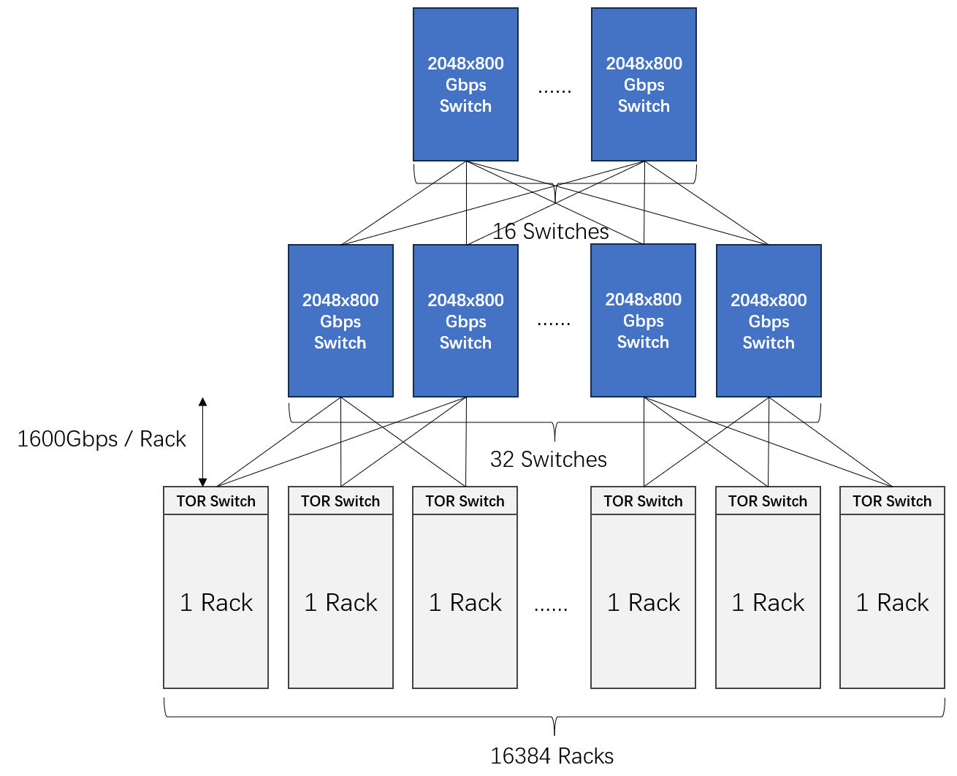
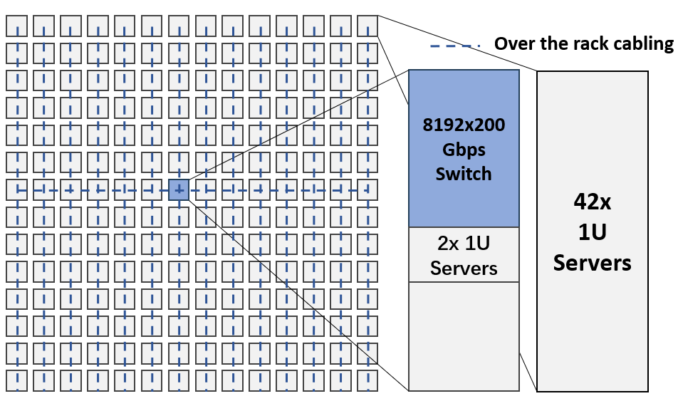
Use Cases for a Radix-8192@200Gbps Waferscale Switch
Hyperscale Data Center
Single-Switch On-Prem Data Center
Massive Singular GPU
8192 servers → 8192 servers
96 switches → 1 switch
16k cables → 8k cables (-50%)
3 hops → 1 hop
192 U → 20 U (-90%)
16384 racks → 16384 racks
4608 switches → 48 switches
163.8k cables → 65.5k cables (-60%)
5 hops → 3 hops
438.8 racks → 22.8 racks (-95%)
256 GPUs → 2048 GPUs
132 switches → 1 switch
115.2 Tbps → 819.2 Tbps
3 hops → 1 hop
195 U → 20 U (-90%)
Notes:
Such switch could be used to drastically reduce costs in a hyperscale datacenter, to build a single switch on-prem data center, or to construct a massive singular GPU. In all these uses cases, we see significant reduction in number of switches, volume, cables, transceivers, hop counts compare to baselines with conventional network switches.

Slide 13
Summary & Conclusion
High radix critical to reducing latency, cost, power, and volume, and improving scale
Radix scaling extremely slow, radical solutions needed for significant increase
Our solution: A waferscale network switch. Promises 32x higher radix.
Achievable radix greatly limited by bandwidth and power concerns
Optimizations such as deradixing and heterogeneity can alleviate these concerns
Can enable a radix-8192@200Gbps waferscale network switch
Novel use cases such as single switch/low cost data centers, massive singular GPUs
A ripe and fruitful area of research!
Notes:
[summary]
Overall, this is a ripe and fruitful area of research.
Thanks for listening, I will be happy to take questions!

Slide 14
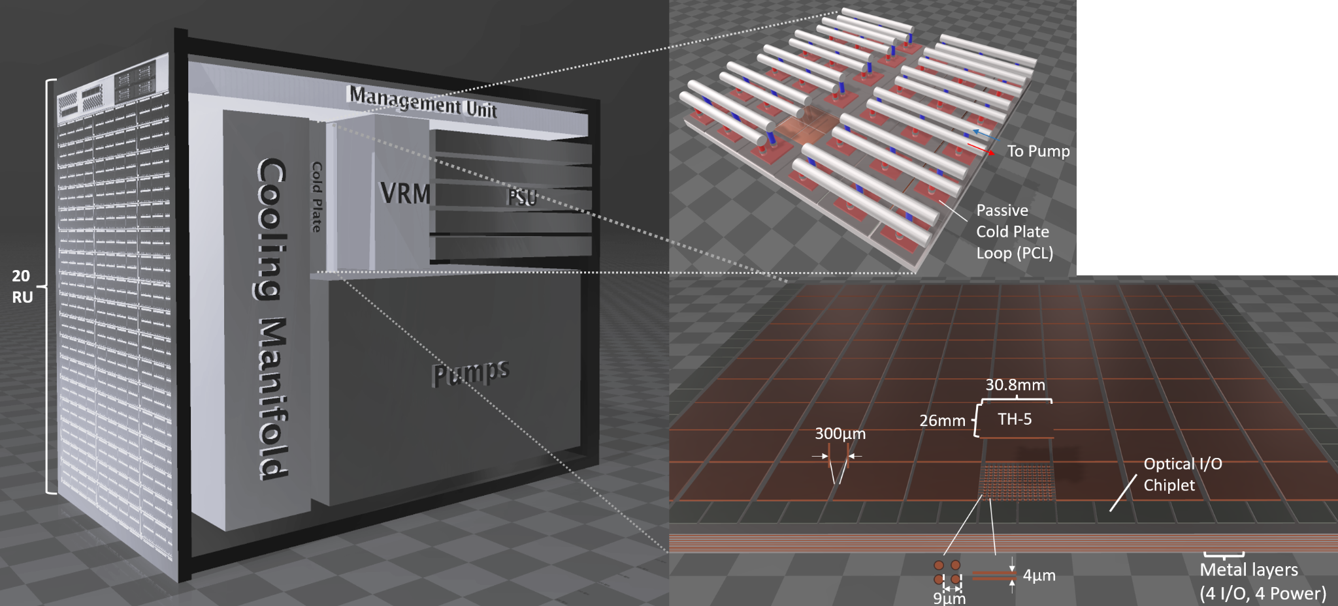
System Architecture
Notes:
The whole system fits inside a 20 RU rack. For context, a typical server is 2 RU, and the entire rack can fit 42 RU.
We used Passive Cold Plate Loop on top of the SSCs and io chiplets for cooling.

Slide 15
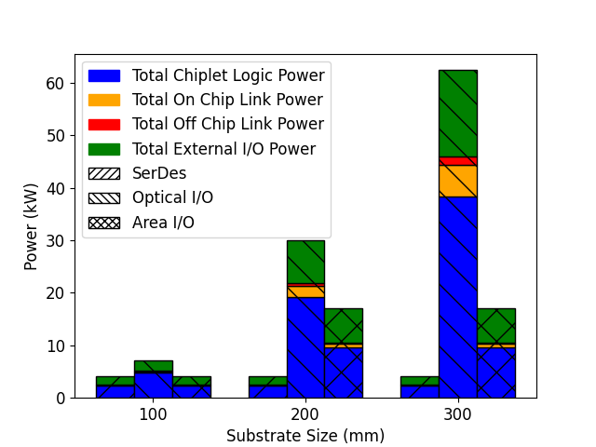
Power and Cooling Challenges May Also Limit Achievable Radix
Handle power and cooling at 63 kW?
Air Cooling Power Budget
Liquid Cooling Power Budget
8192
4096
2048
2048
1024
512
512
512
512
Notes:
Even if we forget about the bandwidth limitations, a waferscale network switch draws *excessive* power. The figure plots the required power for various radix that we achieved. We see that at 8192 radix, the system uses 63kW. This is too high even for liquid cooling. We can only liquid cool the 2048 radix system. The situation becomes much worse if we consider air cooling only.
Introduce the graph better. Graph too complex
If we only talk about 300mm.

Slide 16
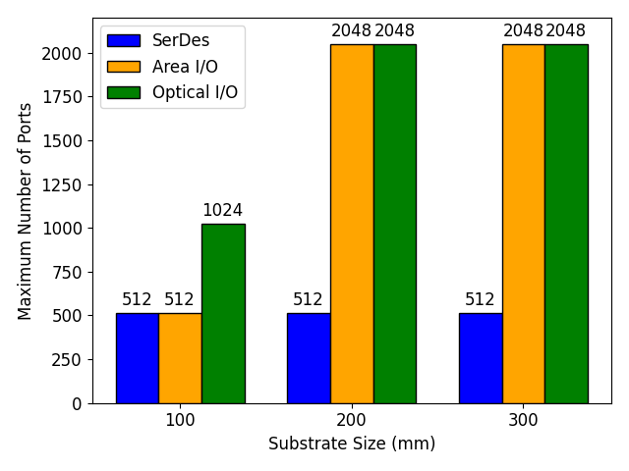
Bandwidth constraints limit the achievable radix
Notes:
The reality is much more complicated. To achieve the promise of 32x higher radix, we need 3000 Gbps/mm of external bandwidth density, 6400Gbps/mm of internal bw density. If we assume SERDES-based external connectivity, we hit only 512Gbps/mm external bw density, so we are severely bottlenecked by io bandwidth. With optical I/O, we can achieve 3200Gbps/mm external bandwidth density, but now we are bottlenecked by internal bandwidth.
For 4 micron internal io pitch, 4 layers of interconnect, and internal links running at 3,2GHz, we have 3200Gbps/mm of internal bandwidth density on the substrate. This discrepancy between requirement and availability reduces the achievable radix. Here we plot the achievable radix with different I/O technologies at 100m 200m 300 mm with 3200Gbps/mm internal bw density. We see only 8x benefit from waferscale integration instead of 32x radix.
Make it a table
Reduce graph

Slide 17
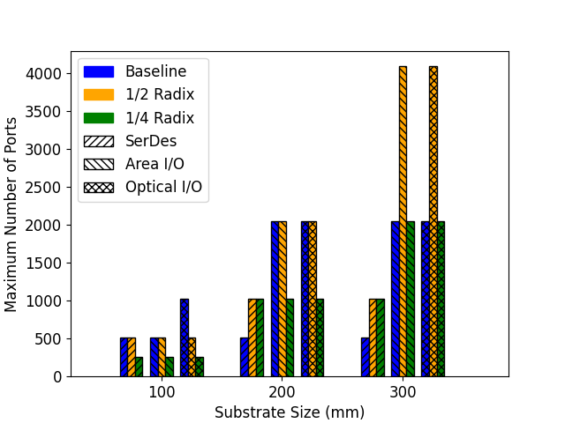
Alleviating Bandwidth Constraint Through Deradixing
Notes:
To address the internal bandwidth problem, we propose the use of deradixing. Using lower radix SSCs that have the same die size, we could alleviate the internal bandwidth congestion.
As we reduce the SSC radix from 256 to 128, the bandwidth utilization went from over 150% at radix 4096 to 90%.
So we can achieve 8x benefits over baseline without deradixing, but 16x with deradixing.

Slide 18
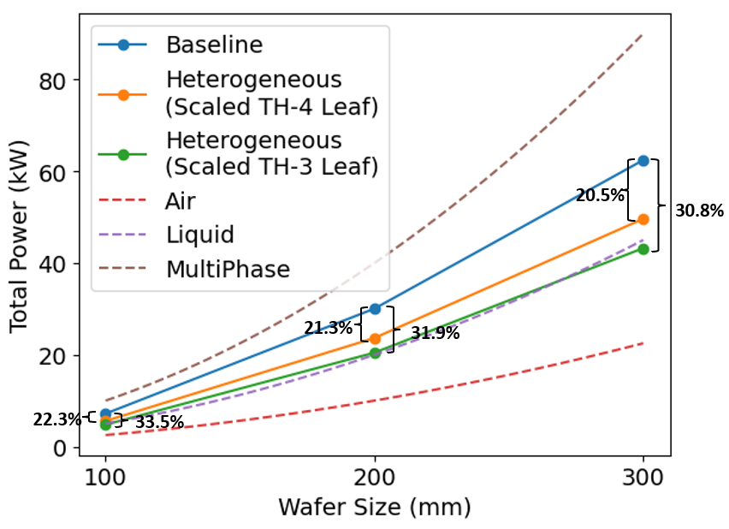
Alleviating Power/Cooling Constraint Through Heterogeneity
Notes:
To address the power consumption problem, we propose to use heterogeneous SSCs with different radixes. We observe that we could use 2 SSCs with half radix as the leaf node without changing the overall radix. We also know that power varies quadratically with radix, so we are able to reduce the overall power when compared to the homogenous SSC system without affecting the system radix. This optimization allows us to cool the 300mm system using liquid cooling. *So*, this 30.8% reduction in power which allows a radix-8192@200 Gbps switch for the same power budget.
Add power scaling to text

